Slide 1
MDEV 1005
jQuery Introduction
Instructor: Mr. Wolski

Slide 2
What is jQuery?
jQuery is a JavaScript library
jQuery takes a lot of common tasks that require many lines of JavaScript code to accomplish, and wraps them into methods that you can call with a single line of code
Last week we covered some of the JavaScript methods to do DOM manipulation and jQuery has a lot of methods to make that easier

Slide 3
Using jQuery
In order to use jQuery, we either download a minified version of it for local use or we can import it in the <head> section of our page from a Content Delivery Network (CDN) like Google
<head> <script src="https://ajax.googleapis.com/ajax/libs/jquery/3.5.1/jquery.min.js"> </script> </head>
If we use the version hosted by Google one advantage is that many other sites already use this version and so it is likely to be cached on the user’s machine already making loading faster. This is the method I recommend

Slide 4
Resources to check out
There are a LOT of resources out there to learn jQuery so I have not tried to replicate them, but mostly link to them or take code snippets
I do recommend that you try the challenge I have at the end of the slides though
Some websites where you can find some good examples or tasks to try include:
Using jQuery & official documentation
Freecodecamp search and basic examples
W3schools

Slide 5
Simple examples of jQuery
jQuery uses the $ symbol to indicate accessing a HTML element or set of elements
In order to use jQuery to manipulate HTML elements we need to make sure the page has finished loading enough to have those elements be accessible
That is why we often use $( document ).ready()
You can use the shorthand version $(function(){ console.log(“ready!”);})

Slide 6
Selecting HTML elements with jQuery
Once you know your elements are ready to be selected, you can find and manipulate them using jQuery selectors
You should notice that these selectors work exactly like CSS selectors
$(“p”) //gets all <p> elements
$(“#demo”) //gets the element with id=“demo”
$(.redCentered) //gets all elements with class=“redCentered”
$("p.intro") //gets all <p> elements with class=“intro”
$(“*”) //gets all elements.
$(":button") // all <button> elements and <input> elements of type="button"

Slide 7
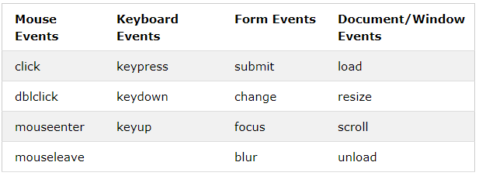
Adding events to Elements
Many event listeners can be easily added to elements using jQuery by using code like this example which adds click event listeners to buttons
Here is a list of some events that are available

Slide 8
Fading/Sliding with jQuery
Instead of just show and hide, you can also fade element in, out have it toggle based on it’s current state, or even have them fade to a specific opacity
It is also easy to control the speed at which this happens $("button").click(function(){ $("#div1").fadeOut(200); //Will take 200 milliseconds to fade out $("#div2").fadeIn(); //uses the default time of 400 milliseconds $("#div3").fadeToggle(3000); //Takes 3 seconds to either fade in or out $("#div4").fadeTo("slow", 0.4); //slow is 600 milliseconds and will go to 40% opacity });
You can also slide elements in a similar way by replacing “fade” with “slide” in the examples above and they don’t have to be divs

Slide 9
Small Challenge For You
Go ahead and try the very small challenges at khanacademy https://www.khanacademy.org/computing/computer-programming/html-js-jquery/jquery-dom-access/pc/challenge-unicorn-ify-a-page-with-jquery
This is just to get used to writing selectors and manipulating them
Can you add some jQuery to fade a list item if it is moused over?

Slide 10
Modifying classes
You can add or remove CSS classes from objects which can change how they look quite easily with jQuery using the
addClass
removeClass and if you want to
alternate toggleClass
You can check out the simple examples here

Slide 11
Creating and Manipulating Elements
You can create new elements in jQuery by simply using the tags var newParagraph = $("<p></p>").text(“Hello World.");
You can also modify any attribute by using .attr // Manipulating a single attribute.
$( "#myDiv a:first" ).attr( "href", "newDestination.html" ); or $('.displayed-img').attr("src",”images/pic1.png”); });

Slide 12
Challenge! Building dynamically with jQuery
You can use jQuery to build up the contents of a site dynamically
Let’s explore a very simple gallery example
On blackboard, download the GalleryExampleStarter.zip file and extract it
Can you modify the code so that it adds the images to the div with class=“thumb-bar”?
Can you add a fade in effect when a thumbnail is hovered over
Can you have the main image change to the one the user clicks on using an animation transition?

